Slide 1
D&D OpenSource VTT

Slide 2
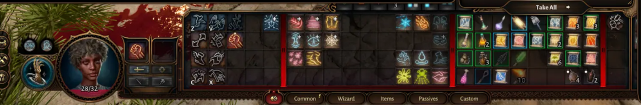
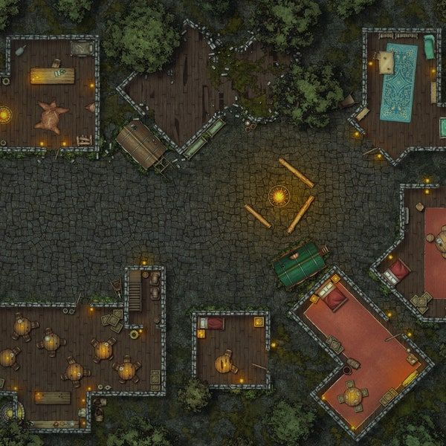
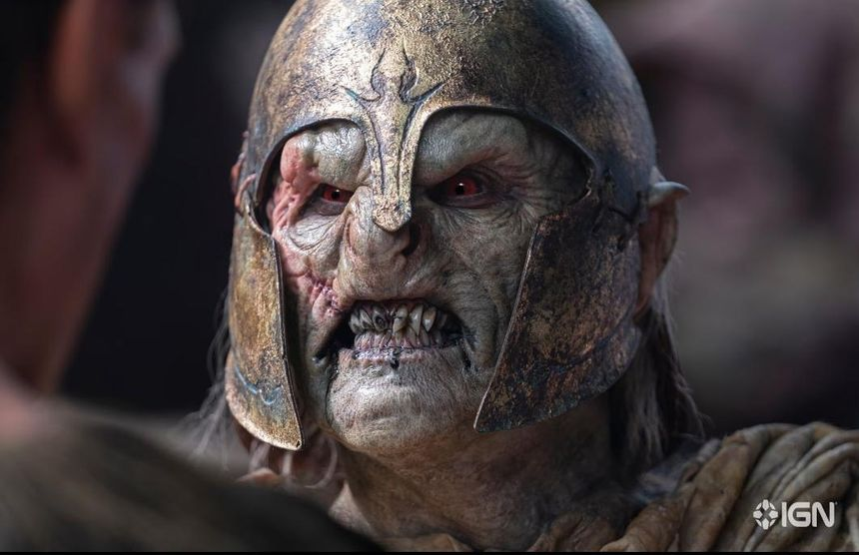
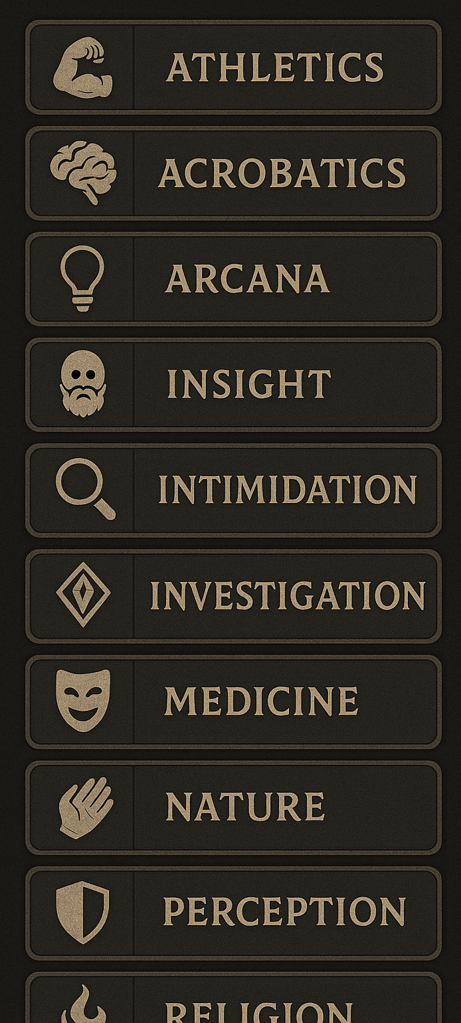
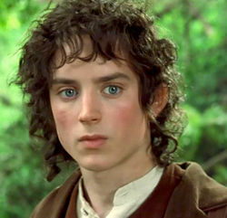
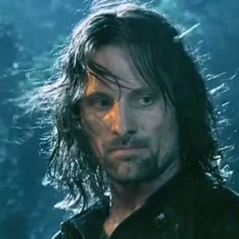
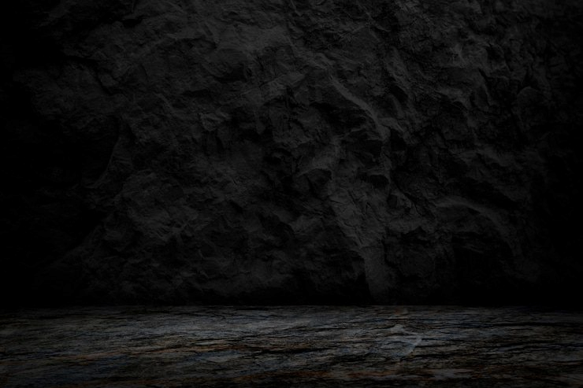
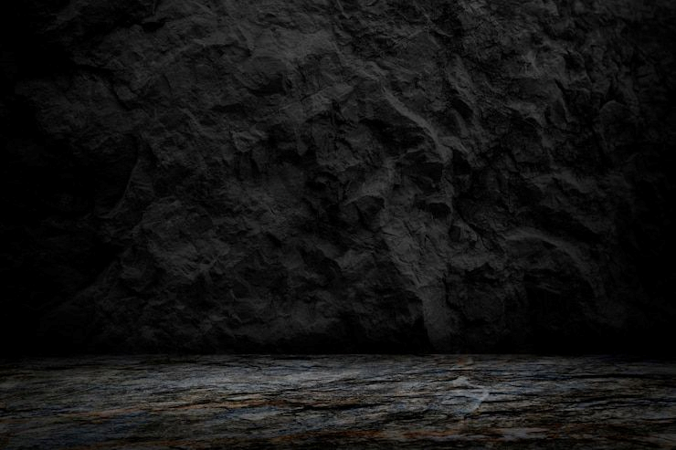


Active
I
II

Slide 3


Check
Save
STR
STR
Check
Save
DEX
DEX
STR
STR
CON
CON
DEX
DEX
INT
INT
CON
CON
WIS
WIS
INT
INT
CHA
CHA
WIS
WIS
CHA
CHA
36 / 47
I
II
Status
Copy Identity

Slide 4
Check
Save
STR
STR
DEX
DEX
CON
CON
INT
INT
WIS
WIS
CHA
CHA
36 / 47
I
II
Status
Copy Identity

Slide 5



Slide 6







Slide 8





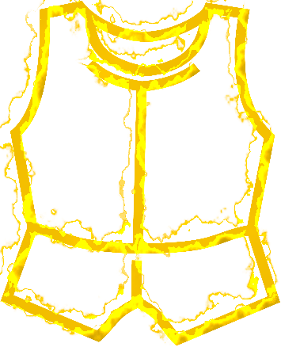

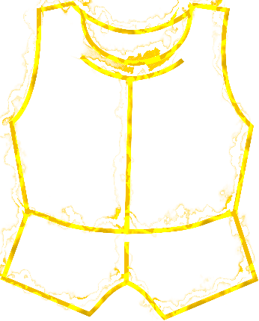





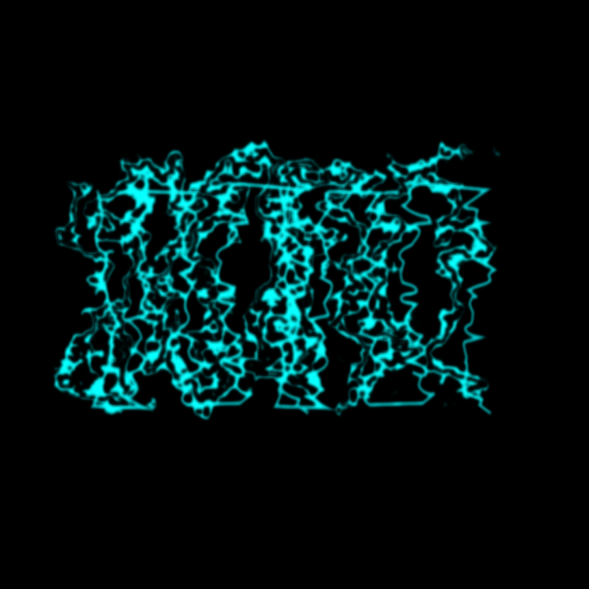
Settings:
Glow:
Color: 251,78,4
Intensity: 0.6
Radius: 0.02
Layers: 3
Expansion: 2
Edge Roughness: 0.6
Chaos Factor: 0.3
Wisp Density: 1
Blur Radius: 1.1

Slide 10



Slide 11
Athletics
Acrobatics
Sleight of Hand
Stealth
Arcana
History
Investigation
Nature
Religion
Animal Handling
Insight
Medicine
Perception
Survival
Deception
Intimidation
Performance
Persuasion
ATHLETICS
ANIMAL HANDLING
ACROBATICS
INSIGHT
SLEIGHT OF HAND
MEDICINE
STEALTH
PERCEPTION
ARCANA
SURVIVAL
HISTORY
DECEPTION
INVESTIGATION
INTIMIDATION
NATURE
PERFORMANCE
RELIGION
PERSUASION

